Slide 1
The Bad Boyz

Slide 2
Solving a Word Search
Design and Analysis of Algorithms for
Created in collaboration with students such as:
Chase
Ryan
John
And Austin

Slide 3

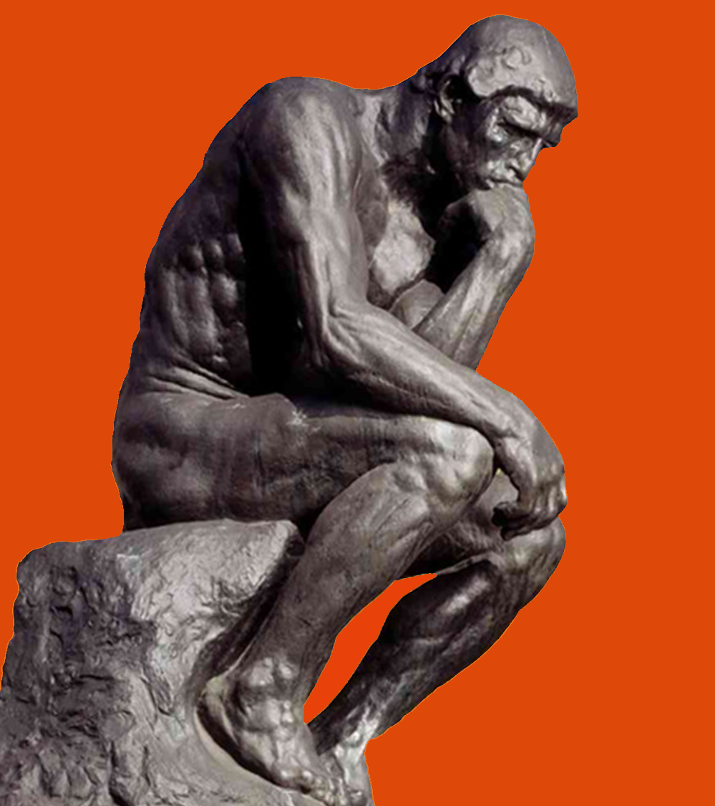
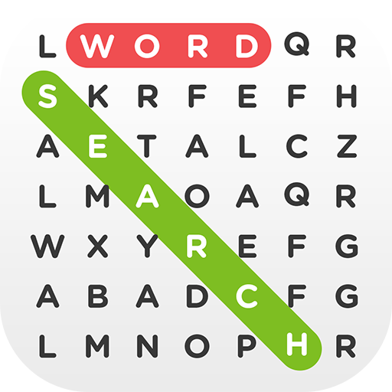
Our Problem
In Natural Language:
Find all words in a given word list within a board of randomly generated characters
Aka a Word Search Puzzle

Slide 4
Formal Statement: Variables
B_{r, c} = matrix of letters comprising game board, r & c indicate position
L = List of words to find: [w₁, w₂, w₃, … w_{i-1}]
where i is the length of L.
W_{k} = a unique sequence of M alphabetic characters
S = sequence of characters for any w ϵ L
M = number of characters in a word
N = number of characters in a sequence
D = list of directions
[(-Y), (+Y), (+X), (-X), (-Y,-X), (-Y,+X), (+Y,-X), (+Y,+X)]

Slide 5
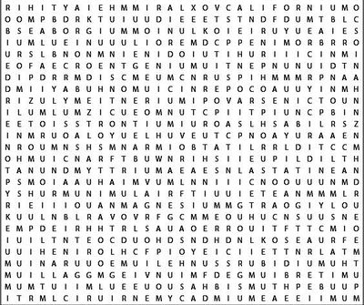
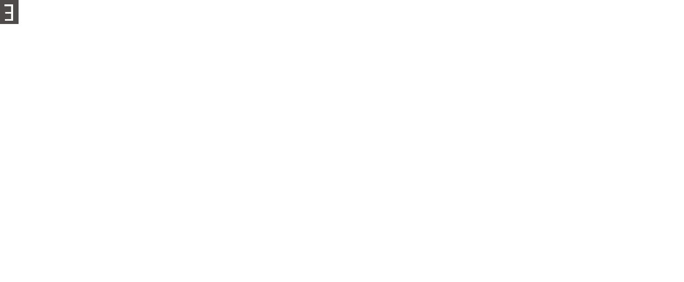
Formal Statement
“For all words W in word list L such that the first character in Word W_{k} exist in Board B at some given coordinate (r,c)…
Alabama
Alaska
Arizona
Arkansas
California
Colorado Connecticut
{
AND
B
The sequence S_{k} of word w_{k} is equal to sequence S_{o} where S_{o} is all combinations of sequences around B_{r, c}”
L
If this statement returns true, the word w_{k} exist at B_{r,c} in direction D
{∀ w ϵ L | (w_{k}[0] B_{r, c}) ∩ (S_{k} = B_{r, c} + (S_{k}-S_{k}[0]) ∀ D_{e} ϵ D | N_{k} = M_{k})} = T/F

Slide 6

Analyzation of the Algorithms
We will have 4 different test
Base Case
Change Board size
Change average word size
Change word list size
The testing consisted of…
10 trials
3 Puzzles
i.e. BaseCase_RunTime $=\frac{\text{(}\text{(}\sum_{n=1}^{10}{\text{P}\text{1}}_RunTime \text{)+ (}\sum_{n=1}^{10}{\text{P}\text{2} }_RunTime \text{)+(}\sum_{n=1}^{10}{\text{P}\text{3}}_RunTime \text{)}\text{)}}{30}$
 | Board Size | Avg Word Size | Word List Size | Iterations
Base Case | 50x50 | 8.18 | 50 | 500-5000
Δ Board Size | 100x100 | 8.18 | 50 | 500-5000
Δ Avg Word Size | 50x50 | 4.0 | 50 | 500-5000
Δ Word List Size | 50x50 | 8.18 | 25 | 500-5000
*Avg Word Size uses a different word list (randomly generated 4 letter words)

Slide 7
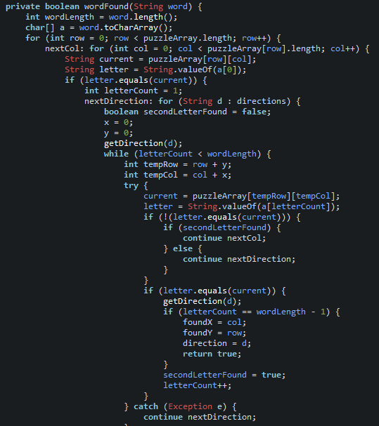
Brute Force
Brute Force checks every possible spot for each word until it is found.
This is obtained naively through the use of nested for and while loops with certain conditions, giving it a time complexity of O(n⁵)
The base case test complete on average in {time here}

Slide 8
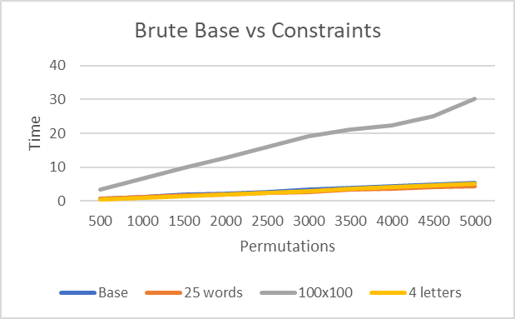
Base Case Vs Constraint Changes
The Brute force method remained fairly consistent throughout the constraints until the increase in board size.
Iterations

Slide 9
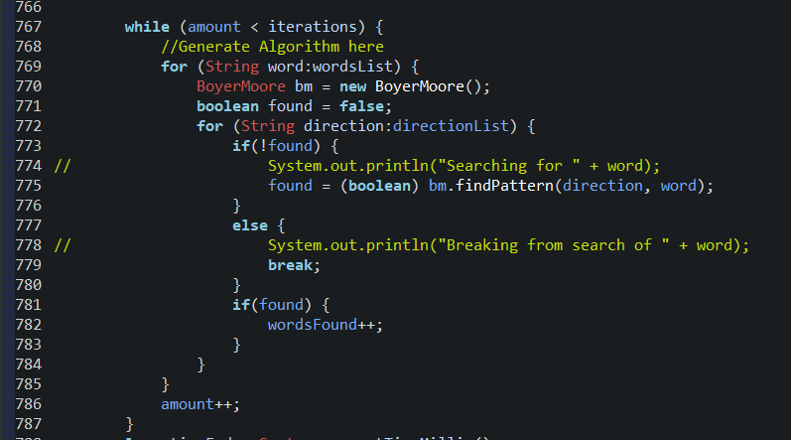
Boyer-Moore
The Boyer-Moore Method relies heavily on pre-processing and converting everything to strings to search for words.
The algorithm employs three loops giving a time complexity of O(n³)
The base case test complete on average in
{time here}
*Real life use: control + F (find in your browser)

Slide 10
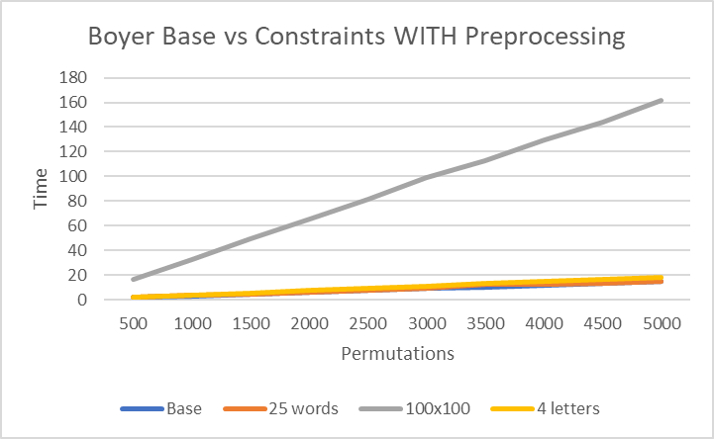
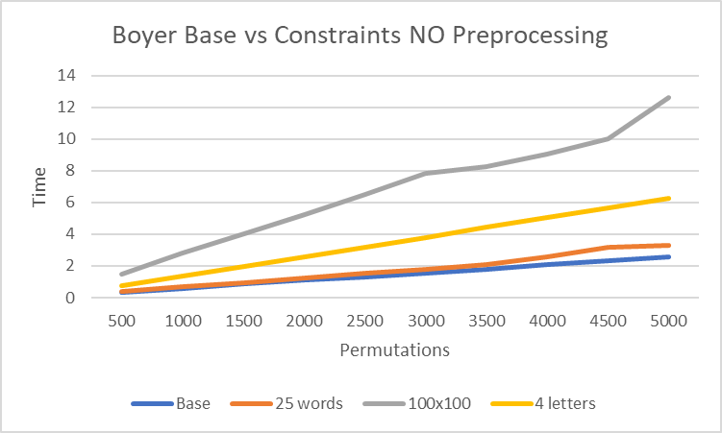
Base Case Vs Constraint Changes
Preprocessing the board dramatically increases the runtime when increasing the board dimension constraint.
The board preprocessing turns the matrix into a string for each direction potentially causing the algorithm to search through 8 times the amount of letters as Brute or Bear methods.
Iterations
Iterations

Slide 11
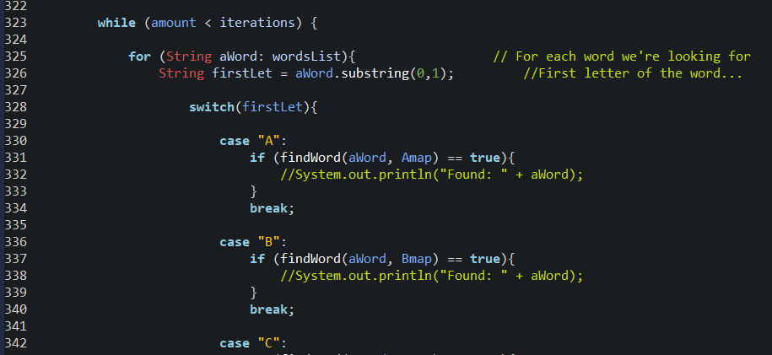
Bear Method
The Bear Method also relies heavily on pre-processing, since it sorts all letters in the board into 26 hash maps based on their letter.
This algorithm employs 4 loops, giving it a time complexity of O(n⁴)
The base case test complete on average in
{time here}

Slide 12
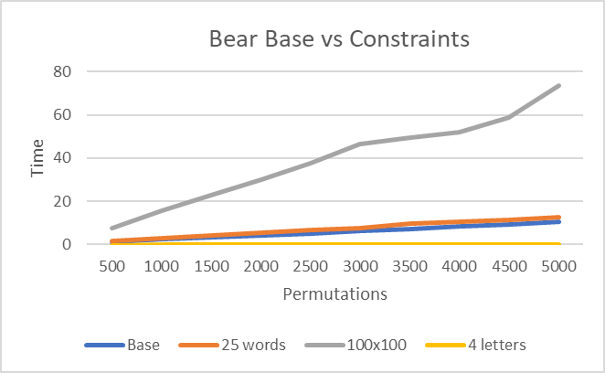
Base Case Vs Constraint Changes
Information about giving algorithm
Iterations

Slide 13
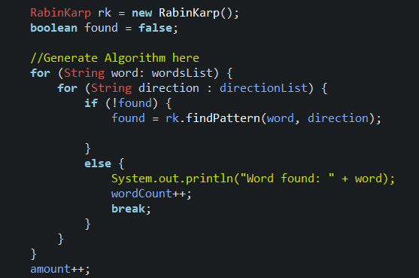
Rabin-Karp
The Rabin-Karp method also relies on pre-processing and converting the board to a string, but in addition, it also uses hash maps.
This method employs three loops giving it a time complexity of O(n³)
The base case test complete on average in
{time here}
*Real life use: plagiarism

Slide 14
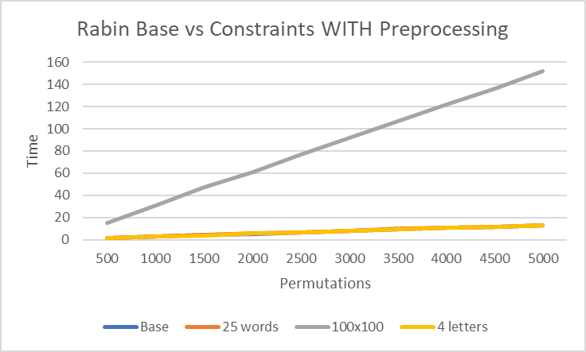
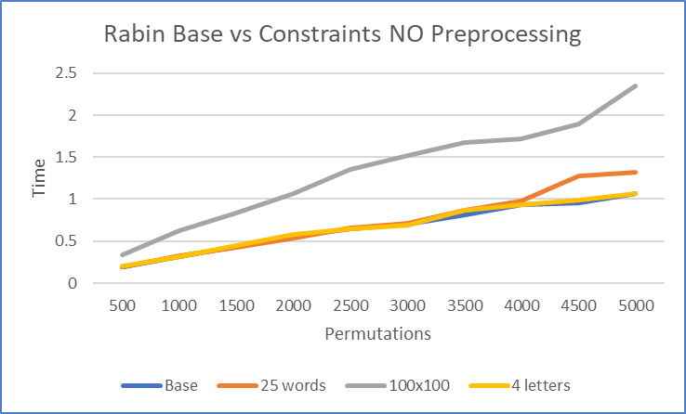
Base Case Vs Constraint Changes
Preprocessing the board dramatically increases the runtime when increasing the board dimension constraint.
The board preprocessing turns the matrix into a string for each direction potentially causing the algorithm to search through 8 times the amount of letters as Brute or Bear methods.
Rabin specific info.
Iterations
Iterations

Slide 15
All 4 Time Complexities and Run Times
 | Time Complexities | Base Case Run Time | Δ Board Size Run Time | Δ Avg. Word Size Run Time | Δ Word List Size Run Time
Brute Force | O(n⁵) | 5.284 | 29.034 | 5.143 | 4.506
Bear | O(n⁴) | 10.52 | 64.254 | 0.026 | 12.452
Boyer-Moore | O(n³) | 14.931 | 161.518 | 18.236 | 15.121
Boyer-Moore* | O(n³) | 2.543 | 12.616 | 6.263 | 3.295
Rabin-Karp | O(n³) | 13.252 | 152.030 | 13.121 | 13.058
Rabin-Karp* | O(n³) | 1.071 | 2.350 | 1.070 | 1.324
* - indicates without preprocessing the data

Slide 16
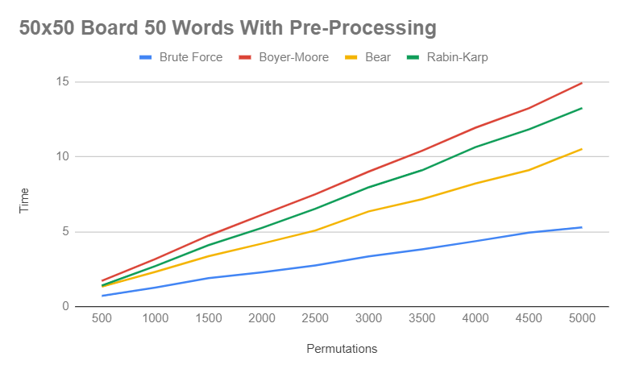
Compare all Base Case
Since preprocessing is needed for the word searches, it was included in this test.
Brute force was the fastest for every permutation while Boyer Moore followed by Rabin Karp were slowest.
Iterations

Slide 17
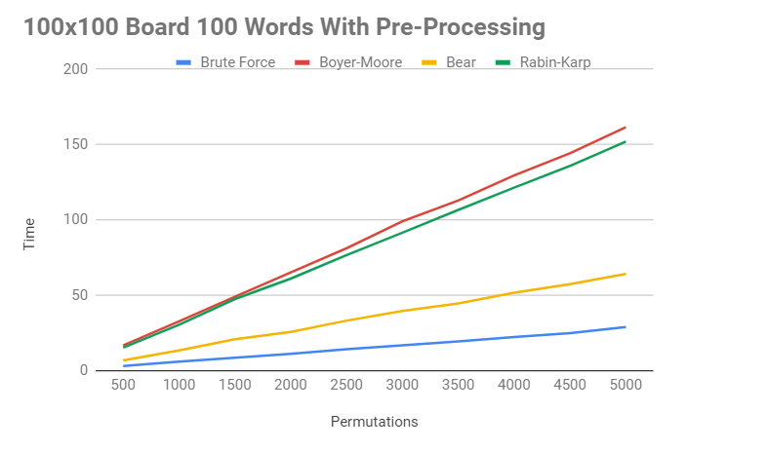
Compare all Δ Board Size
Just like the base case, brute force ends up being the fastest algorithm.
Increasing the board size shows how extreme the preprocessing is for the string searching algorithms.
Iterations

Slide 18

Why Using 4 Letter Words is Viable
When using shorter words in our tests, we considered the fact that shorter words have a greater chance of appearing randomly on a large board.
Since the likelihood of a four letter word appearing randomly in a 50 by 50 word search is less than a hundredth of a percent, we considered it statistically negligible in the context of our research.
$$50×50=2,500 → \frac{2500}{26}≈96.15 → \frac{96.15}{2500}=0.03846$$
$0.0384×\frac{8}{26}×\frac{1}{26}=0.0004$ or 0.04% for a three letter word
$0.0384×\frac{8}{26}×\frac{1}{26}×\frac{1}{26} =$ 0.000017 or 0.0017% for a four letter word

Slide 19
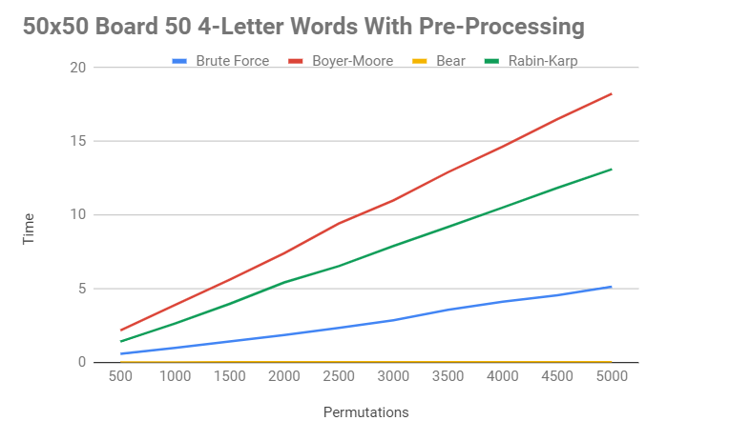
Compare all Δ Avg. Word Size
Bear method ended up being the fastest for the 4 letter word bank searches while Boyer and Rabin remained the slowest.
Iterations

Slide 20
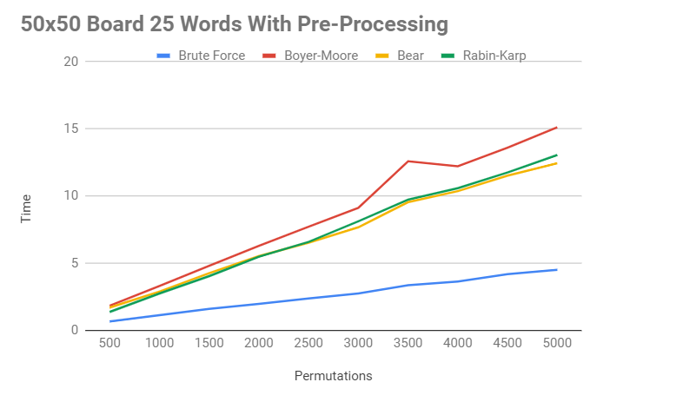
Compare all Δ Word List Size
The order ended up the same as the base case with Brute force being the fastest.
Iterations

Slide 21
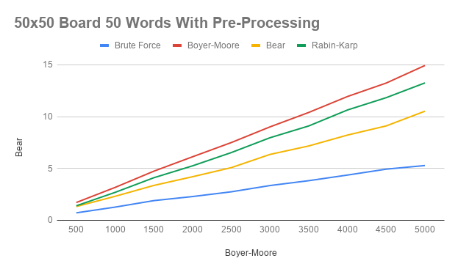
Base Case 50x50 using 50 Words (with Pre-processing)
These Results are with Pre-Processing included in our timed results.
Fastest to slowest in descending order:
Iterations

Slide 22
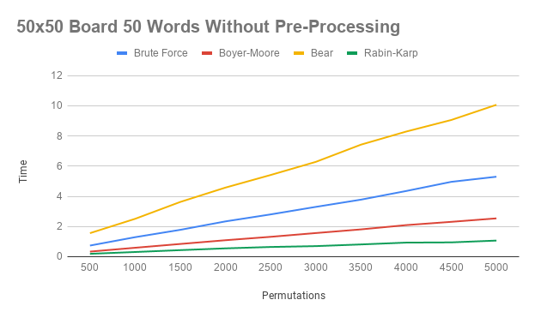
Base Case 50x50 using 50 Words (without Pre-processing)
These Results are with Pre-Processing included in our timed results.
Iterations

Slide 23
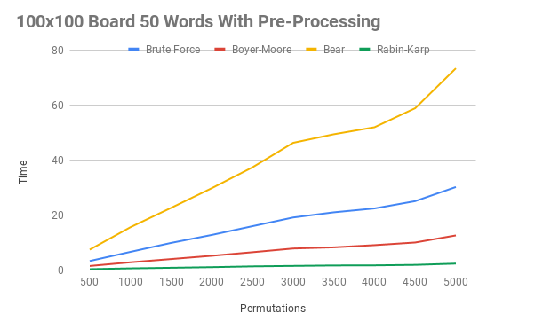
Increased Board Size (with pre-processing)
Iterations

Slide 24
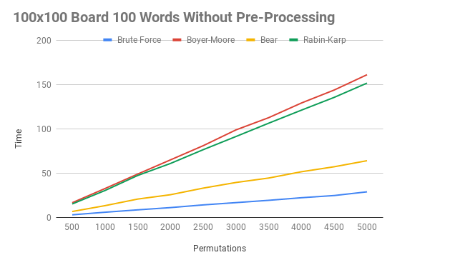
Increased Board Size (without pre-processing)

Slide 25
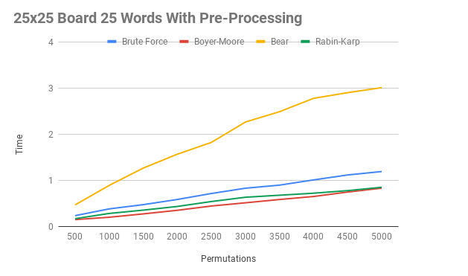
Decreased Board Size (with pre-processing)
Iterations

Slide 26
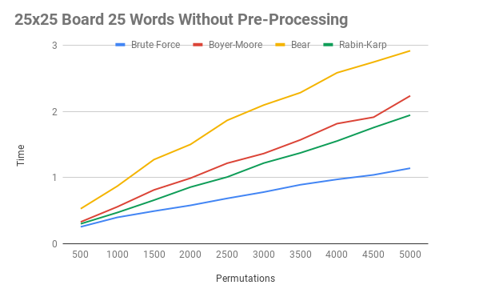
Decreased Board Size (without pre-processing)
Iterations

Slide 27
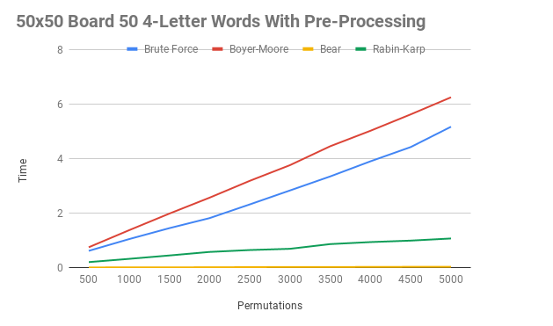
Short Words (with pre-processing)
Iterations

Slide 28
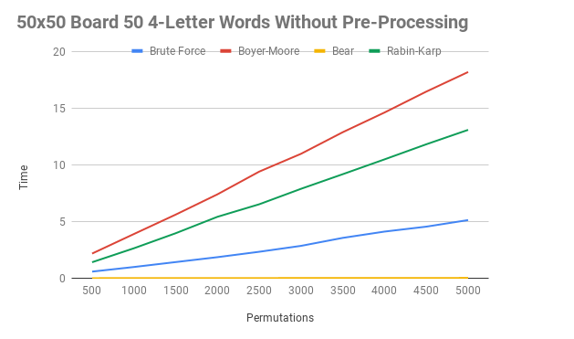
Short Words (without pre-processing)
Iterations

Slide 29
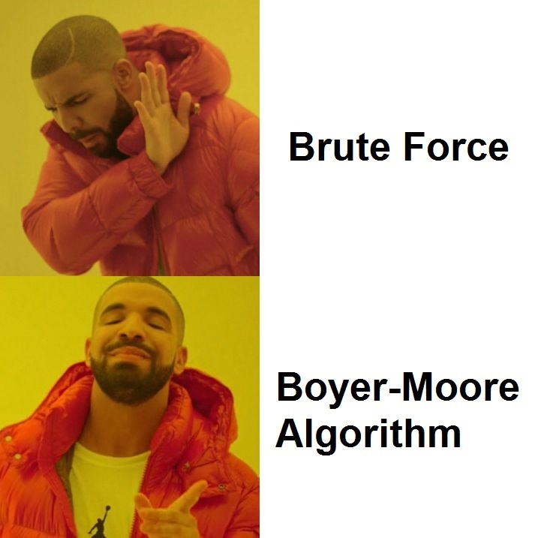
Original Hypothesis
We predict…
Boyer-Moore will be the most efficient algorithm when dealing with a larger data set.
That when changing the constraints to our problem, the performance of each algorithm will be affected.

Slide 30
Conclusion
With a smaller board (Base):
Brute Force and Bear method remain faster due to preprocessing the data for Boyer and Rabin.
With a larger board (100x100):
The Brute Force and Bear method end up faster than the other two since a larger board drastically increases pre-processing speeds.
With smaller words (4 letter):
Bear method ends up fastest because
With fewer words (25 words): The brute force method is faster again due to preprocessing the data for Boyer and Rabin.

Slide 31

Questions?

